Slide 1
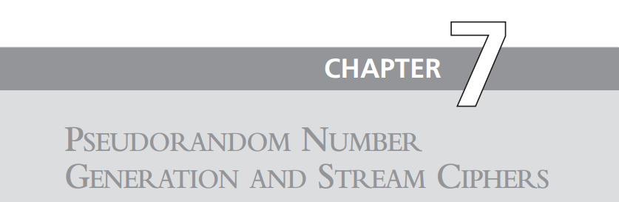
Chapter 7
Razia Nisar Noorani
Asst. Professor
SSUET

Slide 2
The Use of Random Numbers
A number of network security algorithms and protocols based on cryptography make use of random binary numbers. For example,
Key distribution and reciprocal (mutual) authentication schemes, such as those discussed in Chapters 14 and 15. In such schemes, two communicating parties cooperate by exchanging messages to distribute keys and/or authenticate each other. In many cases, nonces are used for handshaking to prevent replay attacks. The use of random numbers for the nonces frustrates an opponent’s efforts to determine or guess the nonce, in order to repeat an obsolete transaction.
Session key generation. We will see a number of protocols in this book where a secret key for symmetric encryption is generated for use for a particular transaction (or session) and is valid for a short period of time. This key is generally called a session key.
Generation of keys for the RSA public-key encryption algorithm (described in Chapter 9).
Generation of a bit stream for symmetric stream encryption (described in this chapter). These applications give rise to two distinct and not necessarily compatible requirements for a sequence of random numbers: randomness and unpredictability.

Slide 3
Criteria
The following two criteria are used to validate that a sequence of numbers is random:
Uniform distribution: The distribution of bits in the sequence should be uniform; that is, the frequency of occurrence of ones and zeros should be approximately equal.
Independence: No one subsequence in the sequence can be inferred from the others.

Slide 4
True Random Number Generator: takes as input a source that is effectively random; the source is often referred to as an entropy source.
Pseudorandom number generator: An algorithm that is used to produce an open-ended sequence of bits is referred to as a PRNG. A common application for an open-ended sequence of bits is as input to a symmetric stream cipher
Pseudorandom function (PRF): A PRF is used to produced a pseudorandom string of bits of some fixed length. Examples are symmetric encryption keys and nonces. Typically, the PRF takes as input a seed plus some context specific values, such as a user ID or an application ID

Slide 5
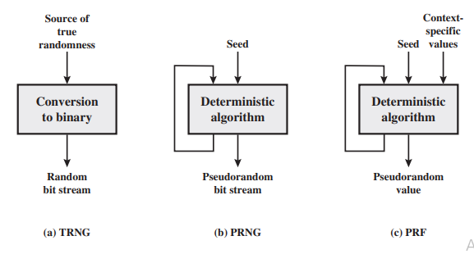
TRNGs, PRNGs, and PRFs

Slide 6
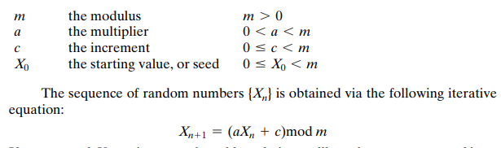
Linear Congruential Generators
A widely used technique for pseudorandom number generation is an algorithm first proposed by Lehmer [LEHM51], which is known as the linear congruential method. The algorithm is parameterized with four numbers, as follows:
If m, a, c, and X0 are integers, then this technique will produce a sequence of integers with each integer in the range

Slide 7
Example
The selection of values for a, c, and m is critical in developing a good random number generator. For example, consider a = c = 1. The sequence produced is obviously not satisfactory. Now consider the values a = 7, c = 0, m = 32, and X0 = 1. This generates the sequence {7, 17, 23, 1, 7, etc.}, which is also clearly unsatisfactory
Of the 32 possible values, only four are used; thus, the sequence is said to have a period of 4. If, instead, we change the value of a to 5, then the sequence is {5, 25, 29, 17, 21, 9, 13, 1, 5, etc.}, which increases the period to 8.

Slide 8
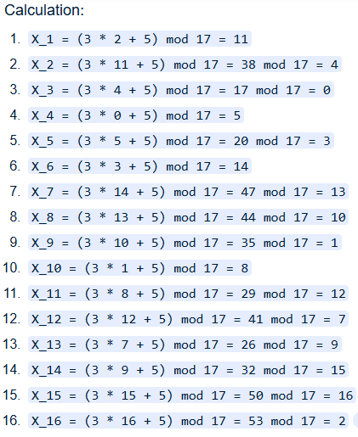
Solution
Parameters: a = 3 (multiplier),
c = 5 (increment),
m = 17 (modulus), and
X0 = 2 (initial seed).
Resulting Sequence: 11, 4, 0, 5, 3, 14, 13, 10, 1, 8, 12, 7, 9, 15, 16, 2

Slide 9
Blum Blum Shub Generator
A popular approach to generating secure pseudorandom numbers is known as the Blum Blum Shub (BBS) generator
Named for its developers [BLUM86]. It has perhaps the strongest public proof of its cryptographic strength of any purpose-built algorithm. The procedure is as follows. First, choose two large prime numbers, p and q, that both have a remainder of 3 when divided by 4. That is,

Slide 10
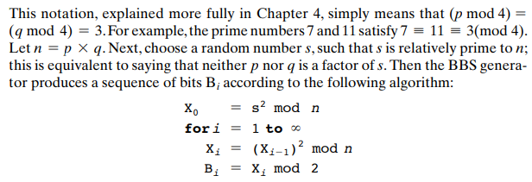

Slide 11
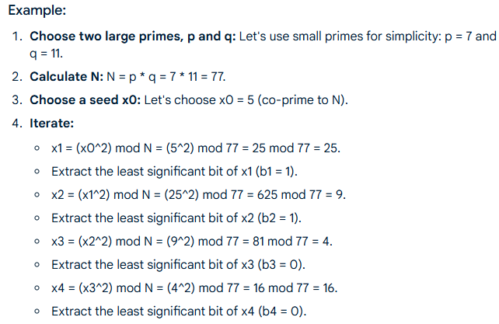
Example:
Output: The generated sequence of bits is 1100.

Slide 12
